Slide 1
Mojaloop Accelerator Program – Zambia
Desire Kachenje - Mojaloop Foundation
Probase || Sparc Systems || iMoSys || iZayne InovSolutions || Netone

Slide 2

Accelerator Overview
The Accelerator program envisions a strong network of local System Integrators (SIs) that are trained to support the deployment, customization, and maintenance of Mojaloop within the continent.
Foundation believes in national sovereignty, meaning for each country where a Mojaloop system is deployed; the government and/or local technology companies are fully capable to operate and maintain their own payment system. We believe this is a cornerstone of digital sovereignty.
Mojaloop accelerators is a hands-on training and mentoring program that runs in parallel with the Mojaloop Proof of concepts projects.

Slide 3





Impact of the Mojaloop Accelerator
An ecosystem of technology companies that are well versed to support Mojaloop Deployments
Decrease the reliance on foreign technology expertise both in implementation and maintenance of Mojaloop
Understand the resources required (local and international) for a Mojaloop deployment and maintenance during the design phase
Include domestic payment technologists in the project design phase of the Mojaloop Deployments
Technology companies are able to contribute back to Mojaloop Community

Slide 4



Partners
Each accelerator cohort will be supported by a local representative who can either be a regulator or a strong private sector actor. This allows for easier advocacy and access to key players within the specific country.

Slide 5







Zambia Accelerator

Slide 6
Mojaloop Accelerator Program – Zambia
ProBase Limited

Slide 7


MOJALOOP
ACCELERATOR PROGRAMME 2023

Slide 8


ABOUT PROBASE
ProBASE Limited is a leading Fintech and ICT company with a strong track record of providing payment and collection solutions to key sectors of the economy both to public and private sector.
Our core competencies lie in our ability to deliver innovative payment solutions, aggregation services, and bespoke solutions for any type of client to address any type of requirements or needs.
Our products and services are used in process automation, reporting, collections, transaction processing & settlements.

Slide 9






OUR CORE
SOLUTION ADDRESS
$
PAYMENTS & COLLECTIONS
DIGITIZATION / PROCESS AUTOMATION
TRANSACTION PROCESSING, ANALYTICS & RECONS
AGGREGATION SERVICES
/ BESPOKE SOFTWARE DEVELOPMENT

Slide 10















OUR PRODUCTS
$
Pensions/ Insurance Contribution (Banked & unbanked)
Cooperatives Development Management & Disbursement/ CDF
Road Tolling
School Management System/ e-Learning
Payments/ Integration/Aggregation
MIS/Analytics tools for decision making
e-TAX
Domestic & Customs
Branchless Banking
Mobile & E-Wallet/ USSD
FISP
Funds Transfer & Cheque Imaging clearing System
Financial Inclusion/ Switching

Slide 11









COUNTRIES WORKED/ OPERATED IN
Serving Sub-Saharan Africa with a wide array of innovative technological services. With deep market knowledge and a focus on customer satisfaction.

Slide 12
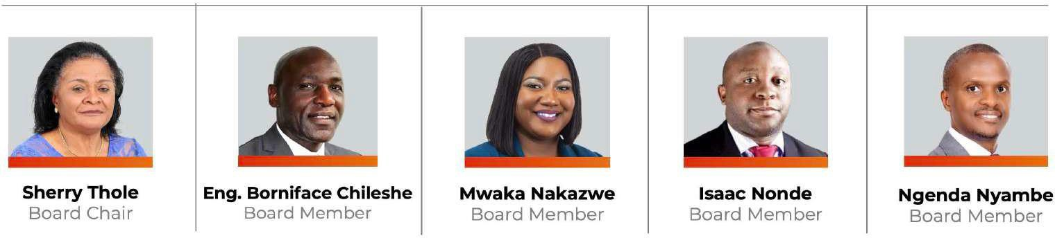

OUR BOARD MEMBERS

Slide 13

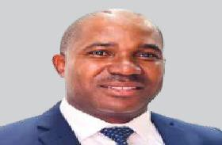
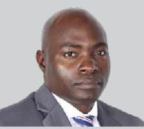
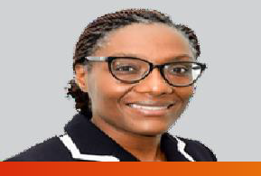
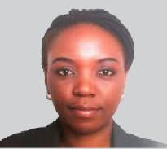
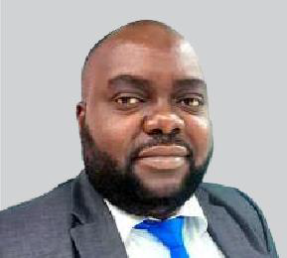



Roy Muyelu
CEO
Lead the development of the company’s short and long- term strategy
implementing the company vision and mission
Maintain expansion opportunities & industry developments
Chola Bwalya
COO
Oversees the company’s business operations
Ensures the company has effective operational and financial procedures in place
Oversees the business commercial division
Mwase Simwase
CIO
Designing & customizing tech systems & platforms
Help Clients maximize applications/systems ROI.
Manage development team personnel
Technological staff recruitment & Retention
Dr. Diana Kangwa
CTO
Tech Support
R&D
Standards
Machine Learning & Artificial Intelligence
Security
OUR EXECUTIVES
Andrea Nyirenda
CxO
Design & delivery of the company’s products & services
User Experience Brand & Consumer Engagement
Moses B. Mwale
CFO
Financial forecasting
Budgets
Financial reporting
Lars Fuglerud
FinTech Service Delivery
Service delivery management
Customer support alignment
Analyze customer requirements
Compliance securement
Zanyiwe Nthatisi
South Africa
Regional policy and regulation specialist
Plan and manage operations and strategy in the SADC region
Oversee quality control, stakeholder and performance management

Slide 14
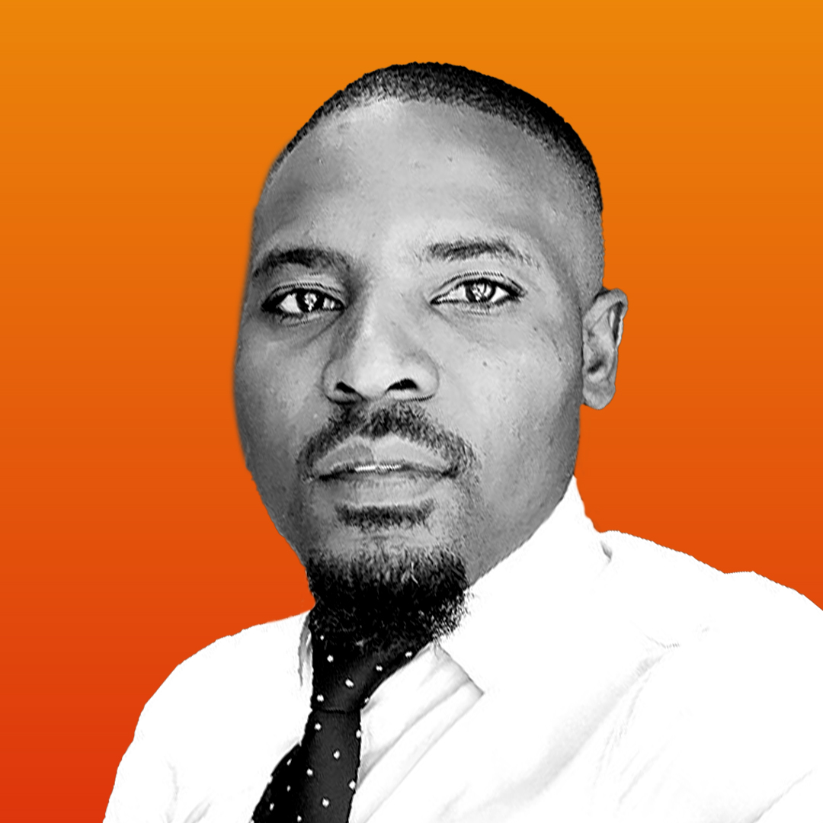
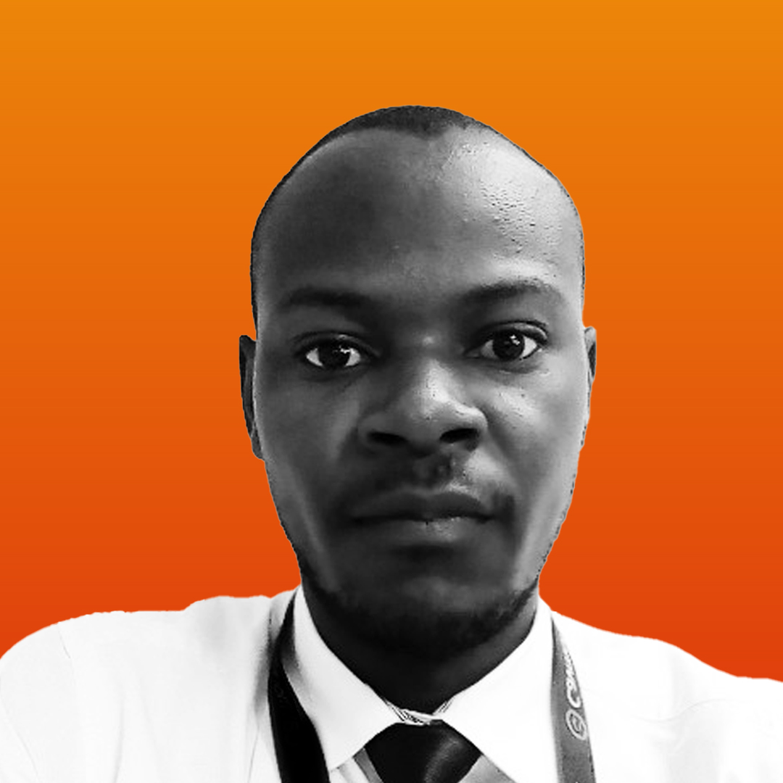




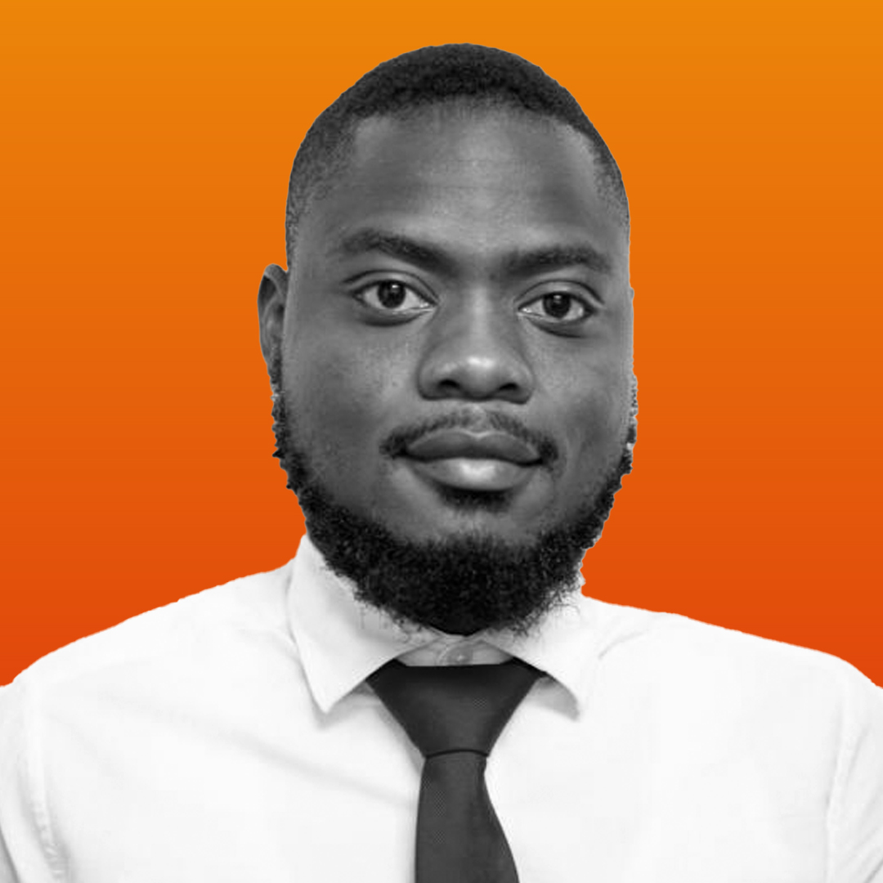
THE PROJECT TEAM
Chiza Mhlanga
Probase Limited
Acting CIO
Samuel Mwale
Probase Limited
Head PMO
Lynn Temwani Zimba
Probase Limited
CRM
Luis Roy Zulu
Probase Limited
Tech Lead
Kakuhu Kabwe
Probase Limited Software Developer
Kachinga Shezongo
Probase Limited
PMO
Telvin Mwanza
Probase Limited Business Analyst

Slide 15
MOJALOOP WORKSTREAM
2. Focus on Merchants and Payments Workstream:
We have specifically chosen to focus on the Merchants and Payments workstream, recognizing the critical role that merchants play in the economic ecosystem.
The team's goal in selecting the Merchants and Payments workstream is to ensure the digital transformation of the payment process.
The aim is to enhance convenience for consumers in the payment experience.
1. Goal of Accelerator Program Participation:
The primary goal of participating in the accelerator program is to familiarize the team with ongoing initiatives.
Identifying opportunities to contribute to digital payments, financial inclusion, and interoperability is a key objective.

Slide 16
KEY HIGHLIGHTS
1. Impactful Alliances:
Partnerships and collaborations within Mojaloop facilitate noteworthy payment solutions.
These alliances play a pivotal role in driving financial inclusion initiatives.
2. Valuable Knowledge and Insights:
The team gained valuable knowledge and insights from involvement with Mojaloop.
Recognized the potential for impactful partnerships and collaborations within the Mojaloop ecosystem.
3. Comprehensive Understanding of Payment Systems:
Mojaloop and DFSP courses provided a structured and well-planned educational approach.
Participants gained a comprehensive understanding of payment systems.
4. Expertise and Innovation:
The educational approach equipped participants with expertise in payment technologies.
Participants are now capable of navigating and innovating within the realm of payment technologies.

Slide 17

THE SOLUTION

Slide 18
SOLUTION EXPECTATIONS
O1
We will develop a cutting-edge and frictionless payment gateway platform. This platform will serve as a bridge between online or physical merchants and various payment methods, enabling secure and efficient transactions.
What sets this system apart is its advanced fraud detection and prevention algorithms, providing an extra layer of security for both merchants and customers.
Additionally, it offers real-time analytics and reporting functionality, allowing merchants to gain valuable insights into their transaction data for informed decision-making.
This system's unique selling point lies in its seamless integration functionality with a wide array of payment methods, ensuring a frictionless payment experience for customers regardless of their preferred payment option.
02
03
04

Slide 19

Thank You

Slide 20
Mojaloop Accelerator Program – Zambia
Sparc Systems Limited

Slide 21

MOJALOOP ACCELERATOR 2023
Blessings Mhango
Technical Manager: Software & Database
Presented by:
E-mail: blessings@sparcsystems.africa

Slide 22

Who are we?
Multinational IT Company
Offices in Malawi, Zambia and Rwanda
Established in 2013 to bring the gap on high-end enterprise IT
About 64 employees mostly Systems Engineers

Slide 23

OUR SERVICES
Virtualization
Data replication - OS, Database or Hardware Clustering
Disaster Recovery configurations
IT Security
Databases
Software Solutions
Systems Integrations
Training & Educational Services

Slide 24
OUR EXPERIENCE
Software Development
UCS SACCO CRM – Integrates with Core Banking software
TNM Enterprise Service Bus - IBM App Connect Enterprise
Mental Lab – VISA Integration
Database
Oracle Database: NBS Bank, NICO Technologies, MTL, MRA
Oracle Exadata Machine: NBS Bank, Standard Bank
Infrastructure
NBS Bank
Airtel
TNM
Reserve Bank of Malawi
MRA

Slide 25









Slide 26
MOJALOOP INVOLVEMENT
COMESA ZAMBIA-MALAWI CROSSBORDER PROJECT
VIBRANT OSS COMMUNITY
FOREIGN EXCHANGE SUPPORT
SKILLS DEVELOPMENT
MENTORS
MFI PAYMENTS

Slide 27
Mojaloop Accelerator Program – Zambia
iMoSys Limited

Slide 28

Making Life Better Through ICT Innovation
iMoSyS

Slide 29
Investing in sustainable innovative digital business with greatest social impact
Dual Realities in Africa: While certain regions experience growth and development, others confront challenges like poverty and inequality.
Malawi is one of the least developed countries in the world
Huge opportunity to adopt technological innovations to facilitate socioeconomic growth in developing countries.
Digital innovations with greatest impact address challenges in key areas which are crucial for the development of Malawi.
Water
Health
Energy
Education
Industrialisation
Agriculture
Innovative technological solutions are applied to solve some of society’s biggest challenges.

Slide 30

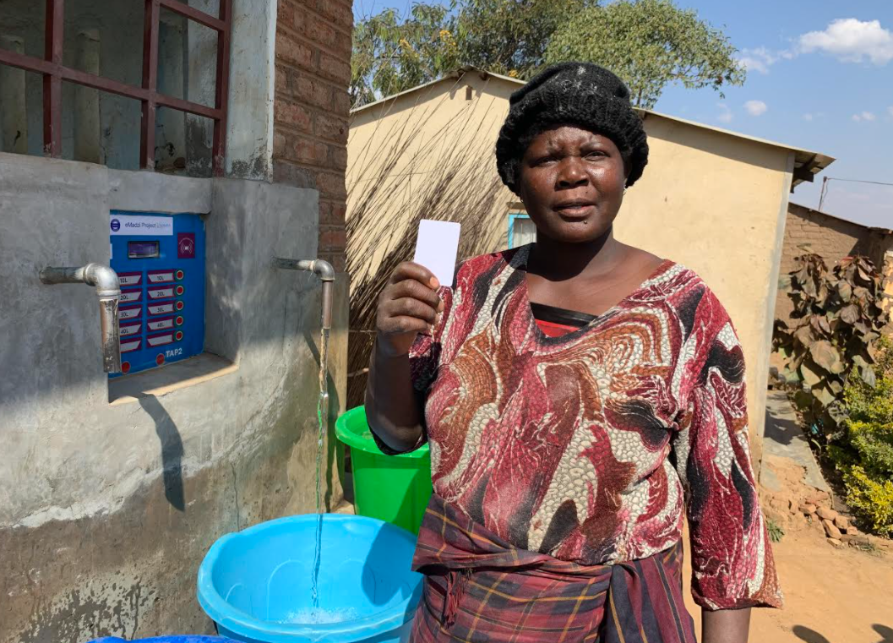



Digital payment solutions by iMoSyS

Slide 31
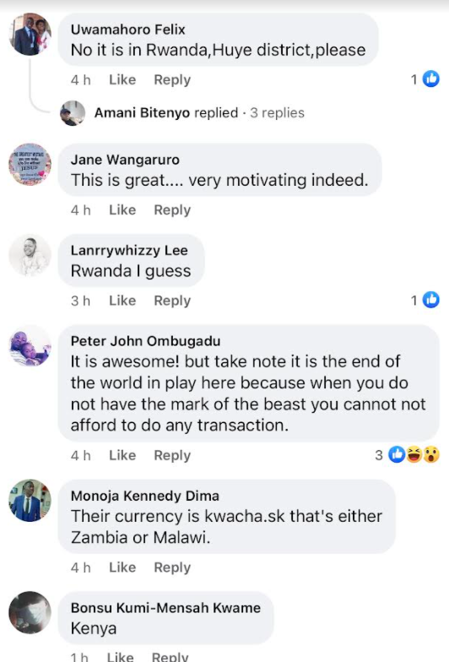
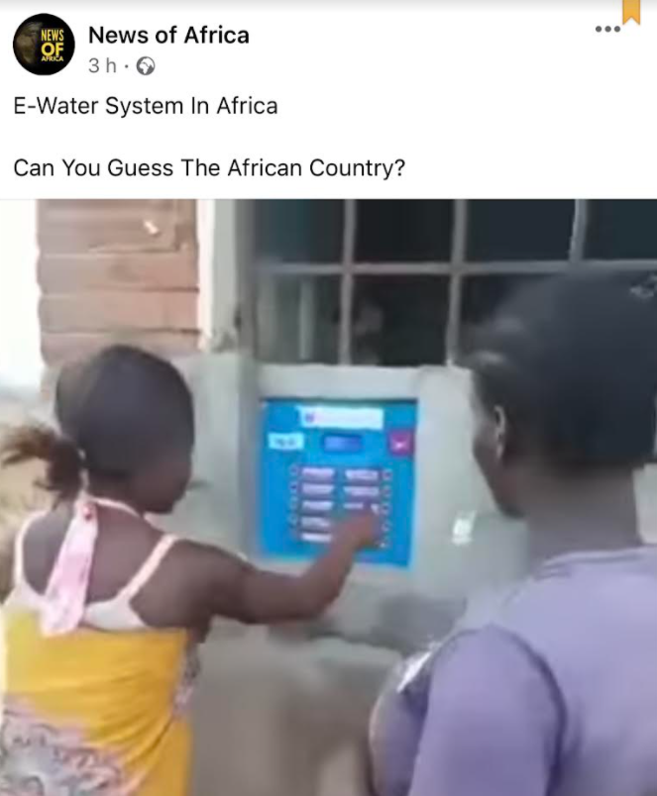
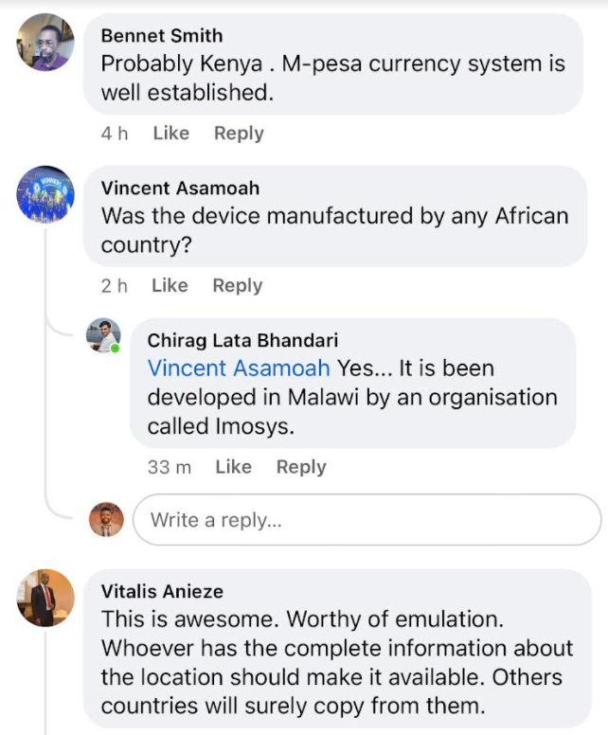
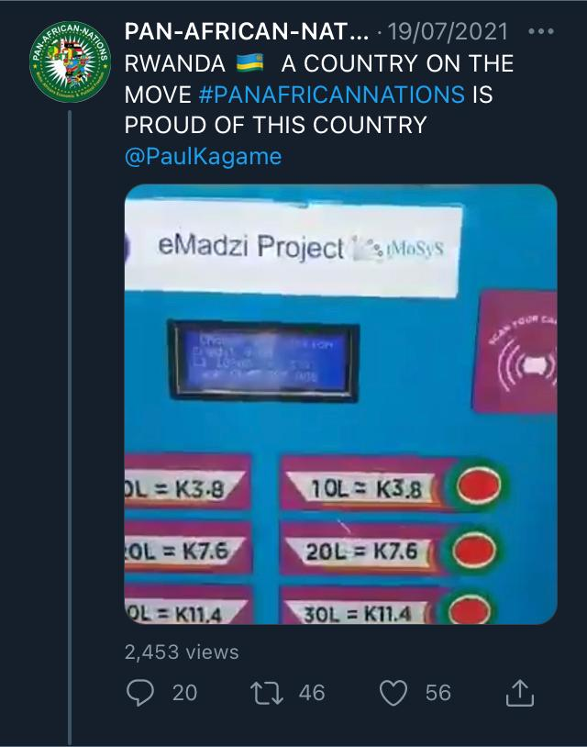
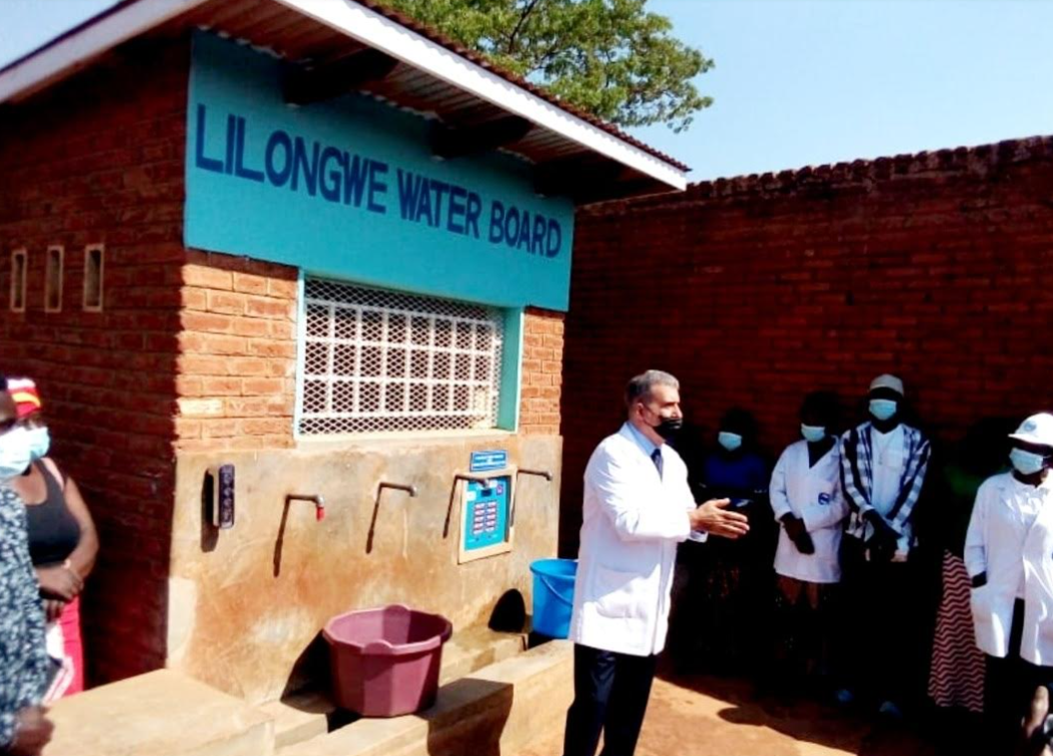

Has opened grant opportunities
£20,000 Grant – Cambridge Africa
€100,000 Grant – SADC/ EU/ GIZ
€300,000 Grant – SADC/ EU/ GIZ
Adopted
Zambia, Madagascar, Zimbabwe
Kenya, Nigeria, etc

Slide 32
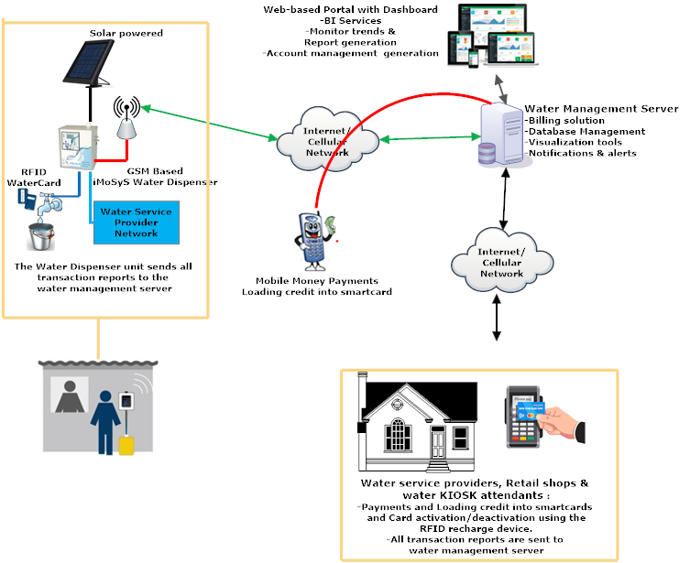
Digital payment solutions by iMoSyS - iTap

Slide 33
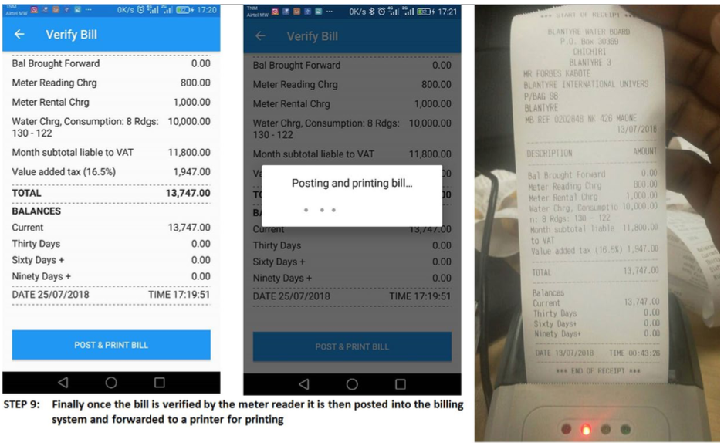
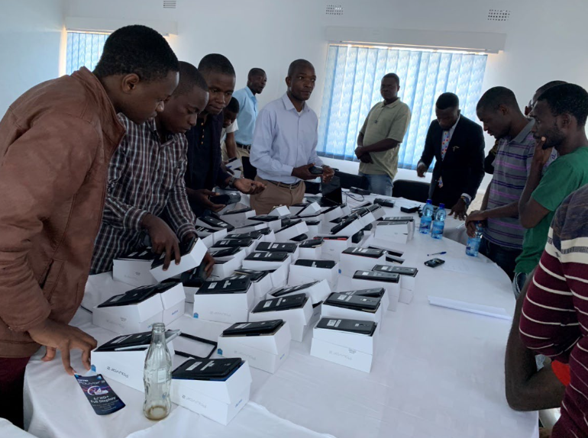
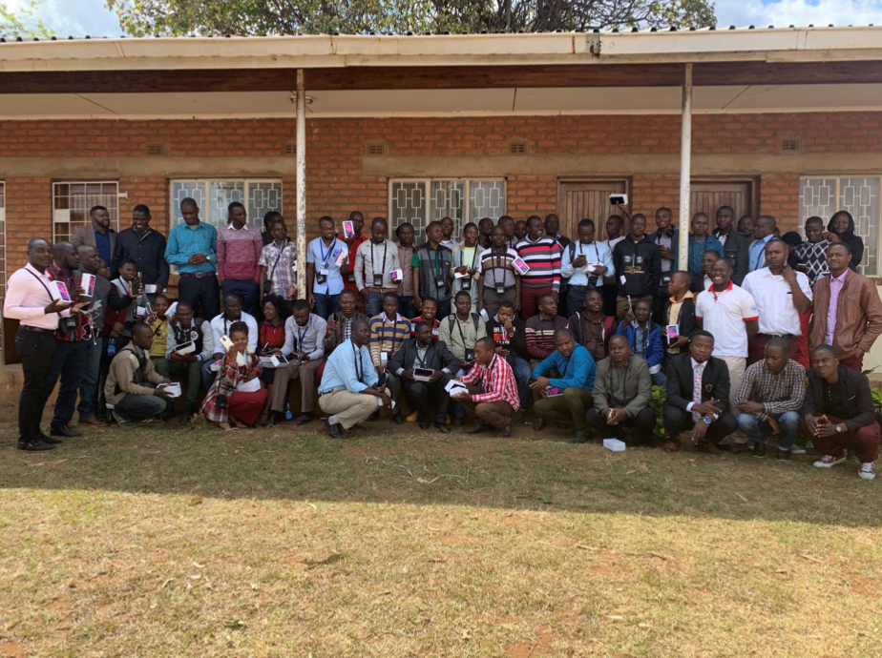
Water utility companies billing system

Slide 34
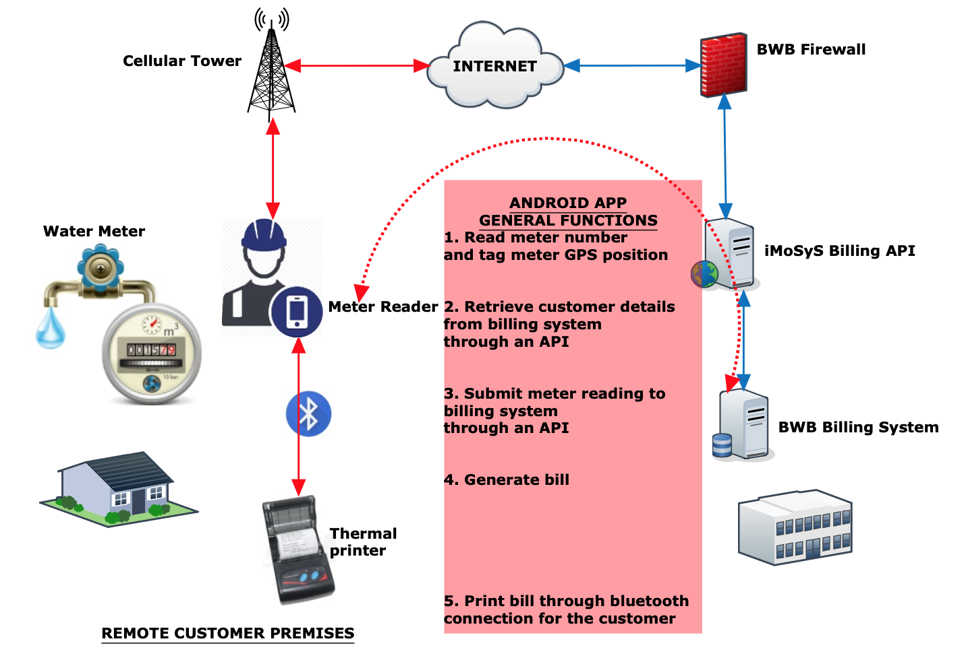
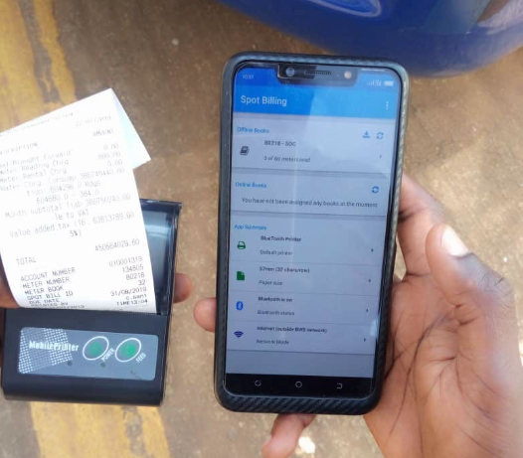
Water utility companies billing system

Slide 35


2023 Most Innovative Tech Solution

Slide 36


Slide 37



Slide 38



Slide 39

Awarded at ITU Telecom world 2018 as an SME with greatest social impact
Recognised by ITU in 2017 and 2018 for providing and promoting innovative ICT solutions with social impact
ICT Association of Malawi Startup Company of the year 2021
ICT Association of Malawi Innovative Tech Solution of the year 2023
Thank you

Slide 40
Mojaloop Accelerator Program – Zambia
iZayne InovSolutions

Slide 41
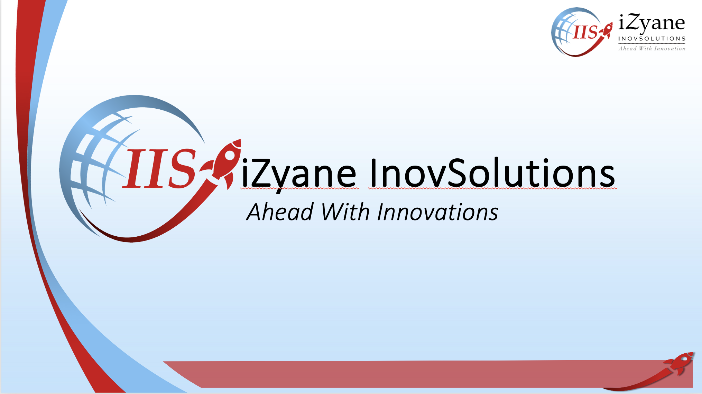

Slide 42
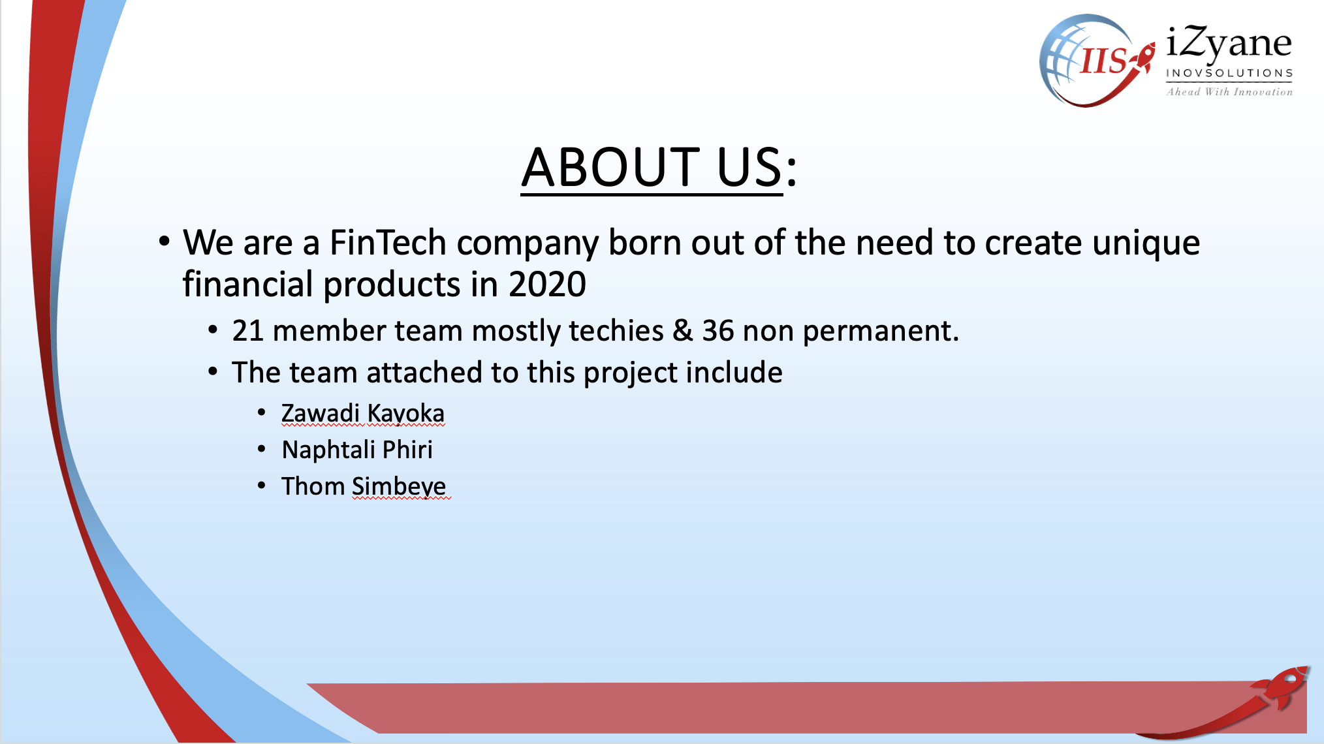

Slide 43
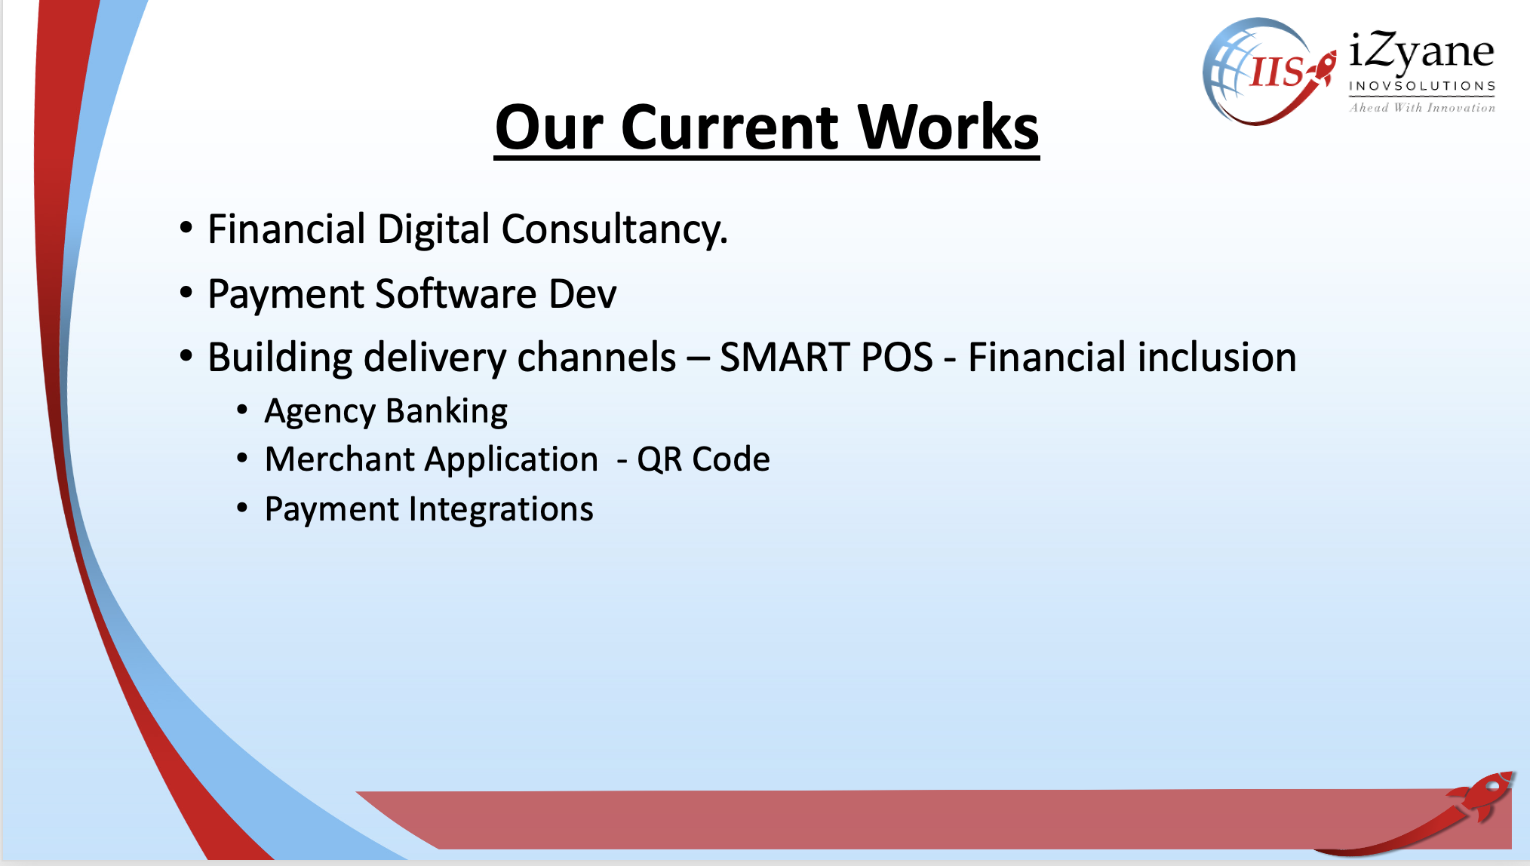

Slide 44
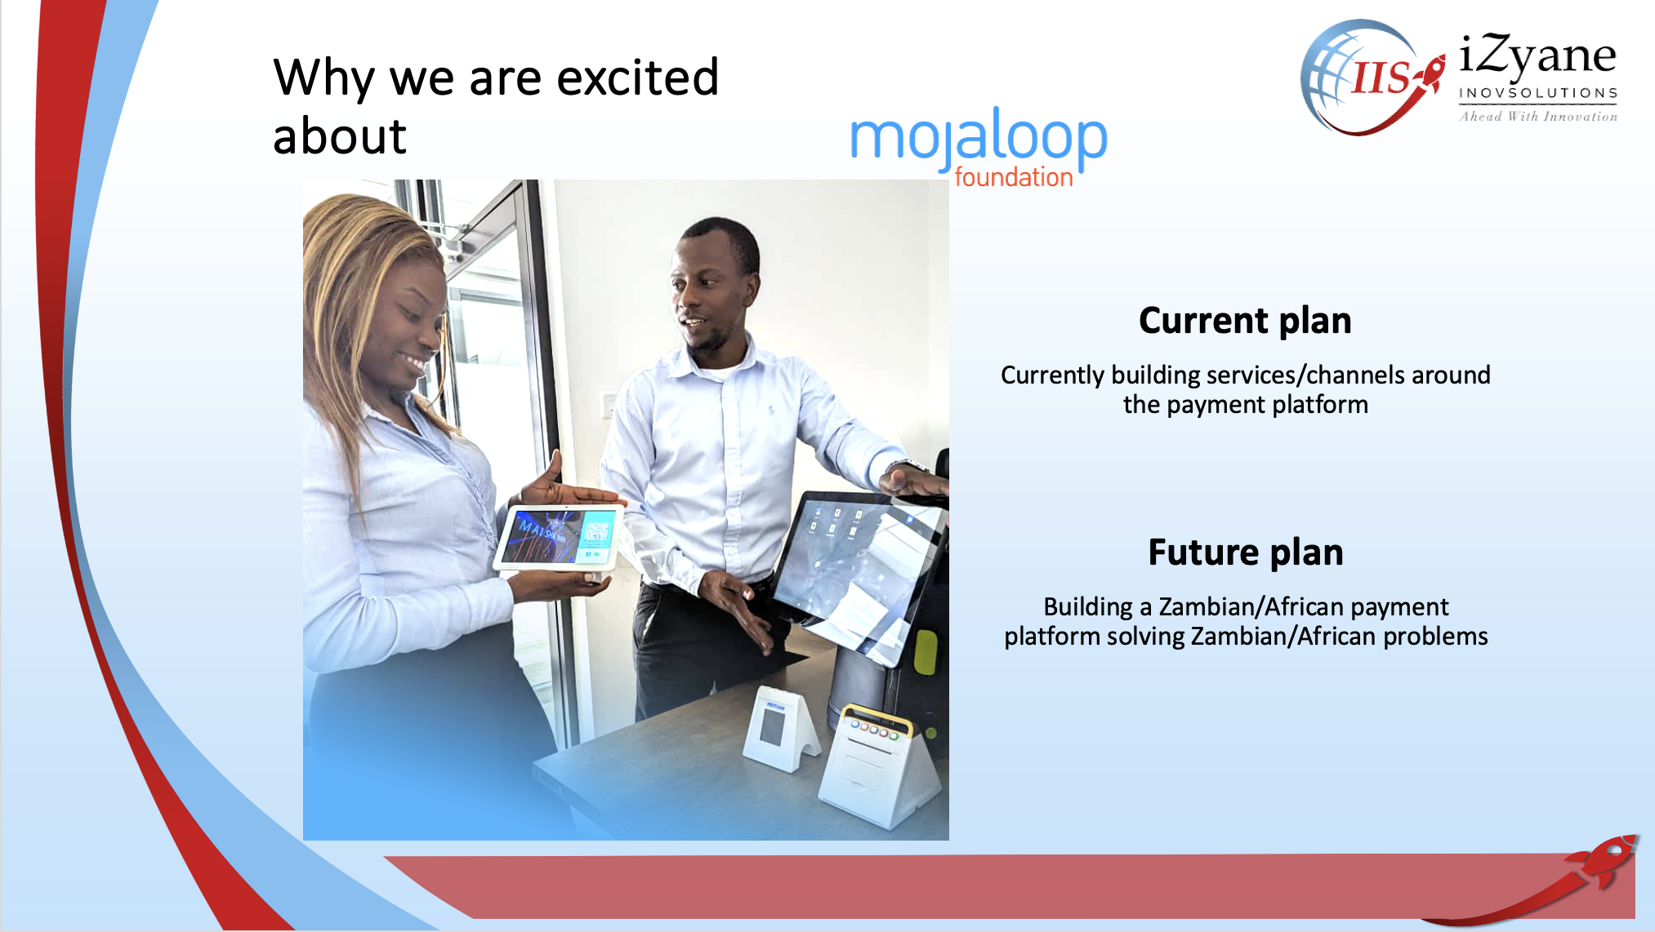

Slide 45
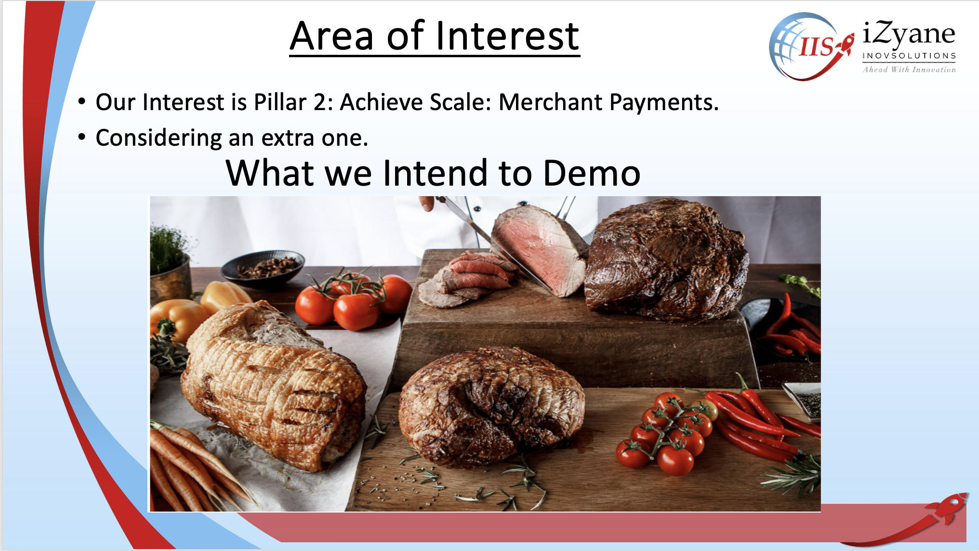

Slide 46
Mojaloop Accelerator Program – Zambia
NetOne

Slide 47
Thank You

